Slide 1

RUNGTA COLLEGE OF DENTAL SCIENCES AND RESEARCH
PREVENTIVE RESTORATIVE PRACTICE
DEPARTMENT OF CONSERVATIVE DENTISTRY AND ENDODONTICS

Slide 2
Specific learning Objectives
At the end of this presentation the learner is expected to know ;
Core areas* | Domain ** | Category #
Introduction | Cognitive | Must know
Definitions | Cognitive | Must know
Classifications | Cognitive | Must know

Slide 3
Content
• Classification of Cervical Lesions
• Carious Cervical Lesions
• Noncarious Cervical Lesion
• Management of Cervical Lesions

Slide 4
WHAT IS TOOTH WEAR ?
Tooth Wear is the loss of tooth surface, which is not caused by decay or by an injury.
  Abnormal Tooth Wear can affect the enamel, dentine and the nerves and blood vessels of the tooth.
There are three categories of Tooth Wear:
Attrition
Abrasion
Erosion

Slide 5
ATTRITION
DEFINITION :
Attrition may be defined as the physiologic wearing away of a tooth as a result of tooth-to-tooth contact, as in mastication.
SITE :
This occurs only on the occlusal, incisal, and proximal surfaces of teeth, not on other surfaces unless a very unusual occlusal relation or malocclusion exists.
CAUSES :
This phenomenon is physiologic rather than pathologic, and it is associated with the againg process.

Slide 6
ATTRITION
CLINICAL FEATURES :
  Attrition commences at the time contact or occlusion occurs between adjacent or opposing teeth. It may be seen in the deciduous dentition as well as in the permanent, but severe attrition is seldom seen in primary teeth.
  2. Occasionally, however, children may suffer from either dentinogenesis imperfecta or amelogenesis imperfecta, and in both diseases pronounced attrition may result from ordinary masticatory stresses.
  3. The first clinical manifestation of attrition may be the appearance of a small polished facet on a cusp tip or ridge or a slight flattening of an incisal edge.
  4. Because of the slight mobility of the teeth in their sockets, a manifestation of the resiliency of the periodontal ligament, similar facets occur at the contact points on the proximal surfaces of the teeth.

Slide 7
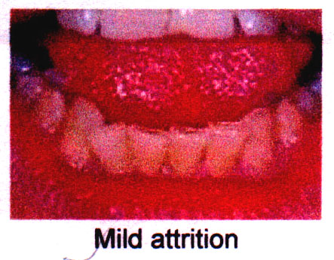
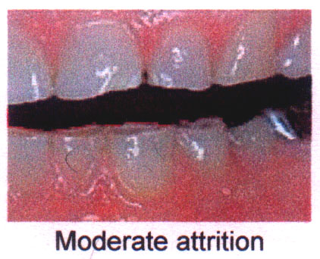
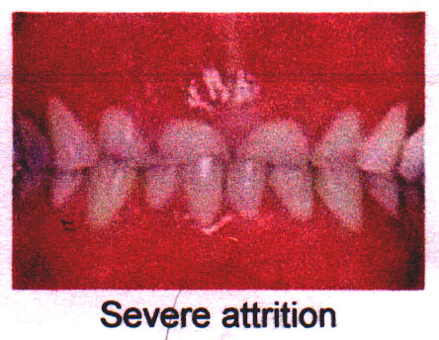
Mild attrition
Moderate attrition
Severe attrition

Slide 8
ATTRITION
  As the person becomes older and the wear continues, there is gradual reduction in cusp height and consequent flattening of the occlusal inclined planes.
  There is also shortening of the length of the dental arch due to reduction in the mesiodistal diameters of the teeth through proximal attrition.
  7. Men usually exhibit more severe attrition than women of comparable age, probably as a result of the greater masticatory force of men.
  8. Variation also may be a result of differences in the coarseness of the diet or of habits such as chewing tobacco or bruxism either of which would predispose to more rapid attrition.
  9. Advanced attrition, in which the enamel has been completely worn away in one or more areas, sometimes results in an extrinsic yellow or brown staining of the exposed dentin from food or tobacco.

Slide 9
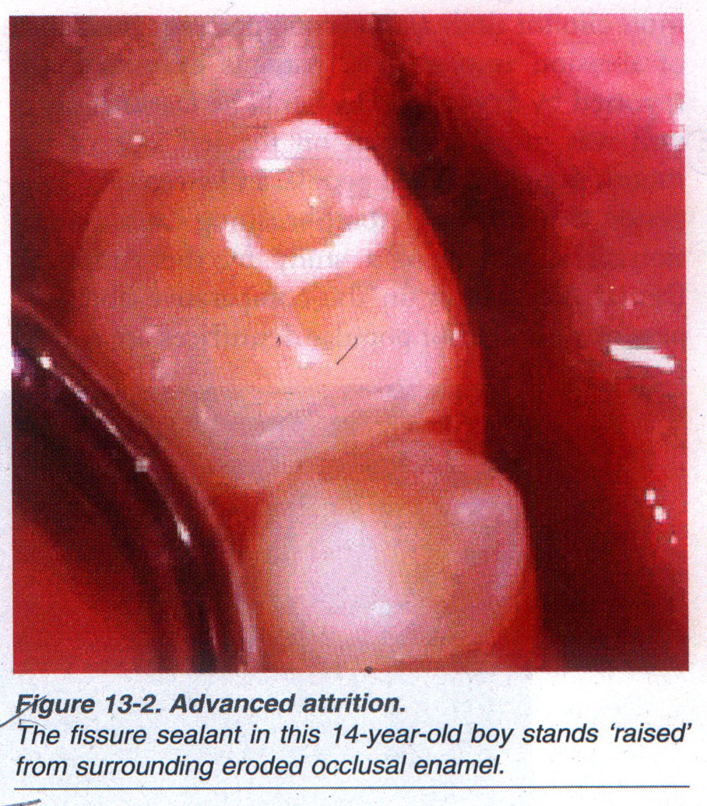
ATTRITION
Advance attrition
The fissure sealant in this 14-year-old boy stands ‘raised’
from surrounding eroded occlusal enamel

Slide 10
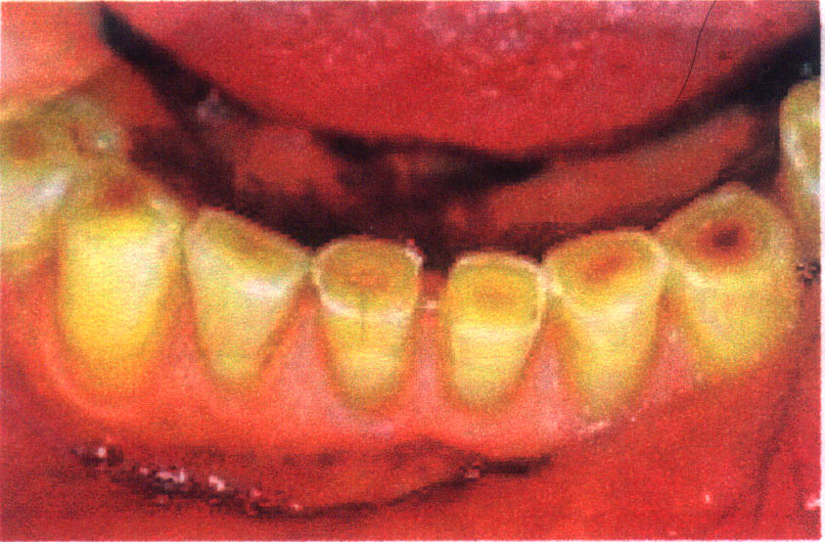
Image demonstrates dental attrition in a 75 year-old patient due to loss of occlusal enamel structure that reveals the underlying dentin

Slide 11
ATTRITION
HISTOPATHOLOGIC FEATURES :
The exposure of dentinal tubules and the subsequent irritation of odontoblastic processes result in formation of secondary dentin pulpal to the primary dentin, and this serves as an aid to protect the pulp from further injury. The rate of secondary dentin deposition is usually sufficient to preclude the possibility of pulp exposure through attrition alone.

Slide 12
WHAT IS BRUXISM ?
Bruxism is the involuntary grinding and clenching of teeth.
  It can take place during waking hours, but occurs more commonly while people are asleep.
  The causes of Bruxism are considered to be stress, anxiety and the abnormal positioning of jaws and of teeth
  The effects of bruxism can be remedied and made more comfortable, by the use of a nightguard.
  It is made of a soft plastic material and worn when you are asleep.
  An acrylic bite plate will also have a similar effect.

Slide 13
Tooth wear index
Score/surface
B / L/ O / I
C
B/L/O/I
C
B/L/O
I
C
B/L/O
I
C
B /L/O
I
C
Criteria
No loss of enamel surface characteristics
No change of contour
Loss of enamel surface characteristics
Min.loss of contour
Loss of enamel exposing dentin ( < 1/3 of surface )
Loss of enamel just exposing dentin
Defect less than 1mm deep
Loss of enamel exposing dentin ( > 1/3 of surface )
Loss of enamel & dentin but not exposing pulp
Defect 1-2 mm deep
Complete loss of enamel or pulp exposure
Exposure of pulp / secondary dentin
Defect > 2mm deep / pulp or secondary dentin exposure
0
1
2
3
4
B – buccal / L – lingual / O – occlusal / I – incisal / C - cervical

Slide 14
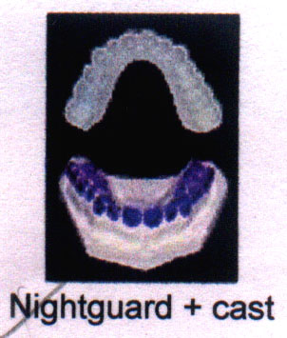
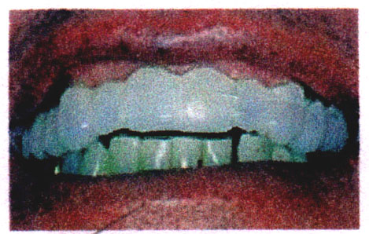
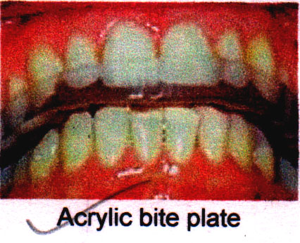
Nightguard + cast
Nightguard over teeth
Acrylic bite plate

Slide 15
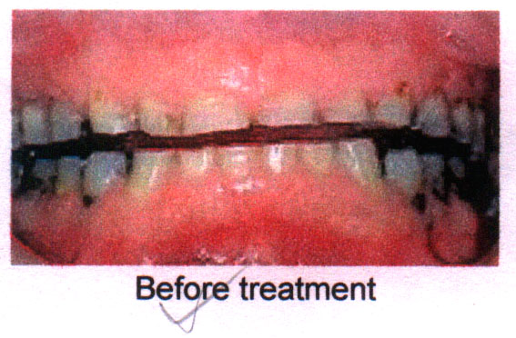
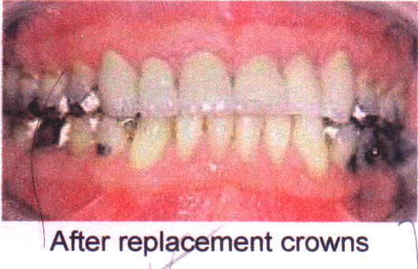
TREATMENT
  The damage to teeth caused by attrition is best repaired with replacement crowns or onlays.
  They restore the size of the shortened and flattened teeth.
  The bite and chewing relationship (occlusion) between the upper and lower teeth will be restored.
  Any sensitivity to hot and cold is eliminated by covering the previously exposed dentine by dentin bonding agents.
  The aesthetics of the teeth, mouth and face can be improved dramatically.
Before treatment
After replacement crowns

Slide 16
ABRASION
DEFINITION
Abrasion is the pathologic wearing away of tooth substance through some abnormal mechanical process.
SITE
Abrasion usually occurs on the exposed root surfaces of teeth, but under certain circumstances it may be seen elsewhere, such as on incisal or proximal surfaces.
CAUSES
  The most common cause of abrasion of root surfaces is the use of an abrasive dentifrice. Although modern dentifrices are not sufficiently abrasive to damage intact enamel severely, they can cause remarkable wear of cementum and dentin if the toothbrush carrying the dentifrice is injudiciously used, particularly in a horizontal rather than vertical direction.
  The habitual opening of bobby pins with the teeth may result in a notching of the incisal edge of one maxillary central incisor. Similar notching may be noted in carpenters, shoemakers or tailors who hold nails, tacks, or pins between their teeth.

Slide 17
ABRASION
  3. Habitual pipe smokers may develop notching of the teeth that conforms to the shape of the pipe stem
  The improper use of dental floss and toothpicks may produce lesions on the proximal exposed root surface.
CLINICAL FEATURES
  Abrasion caused by a dentifrice manifests itself usually as a V-shaped or wedge-shaped ditch on the root side of the cementoenamel junction in teeth with some gingival recession.
  The angle formed in the depth of the lesion, as well as that at the enamel edge, is a rather sharp one, and the exposed dentin appears highly polished.
  The fact that abrasion was more common on the left side of the mouth in right-handed people, and vice versa, suggested that improper toothbrushing caused abrasion

Slide 18
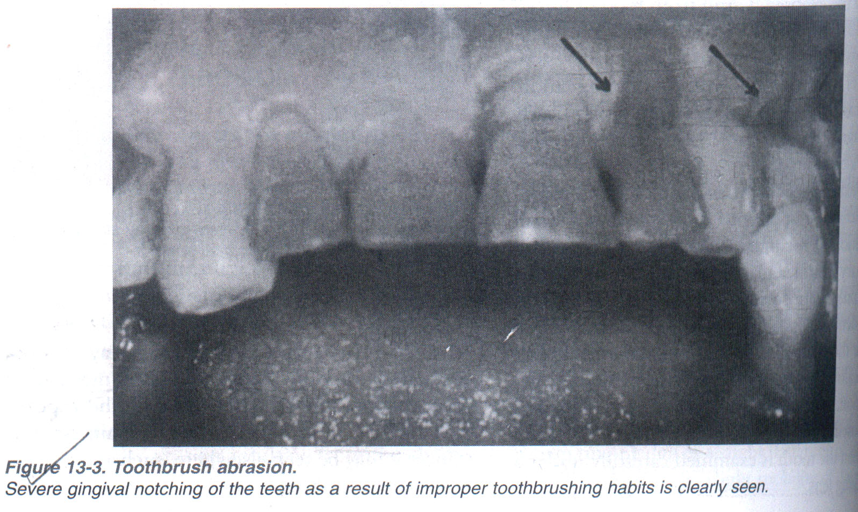

Slide 19
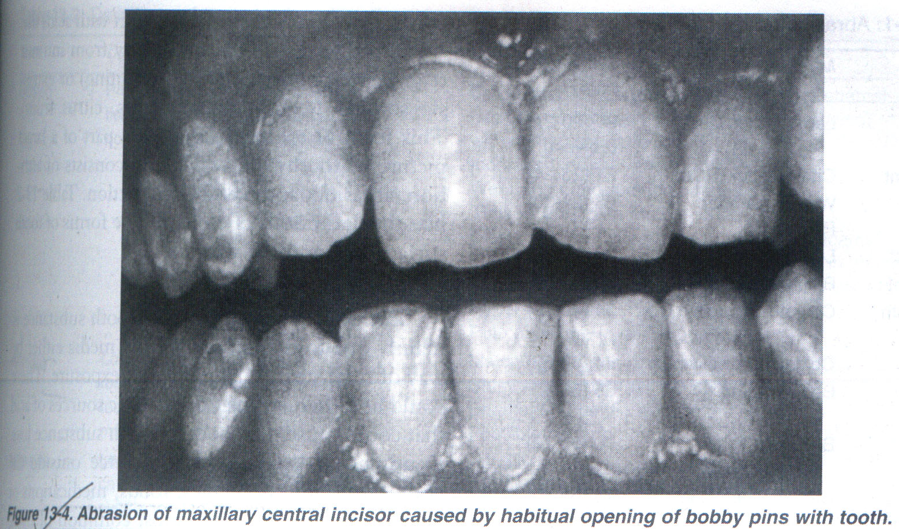

Slide 20
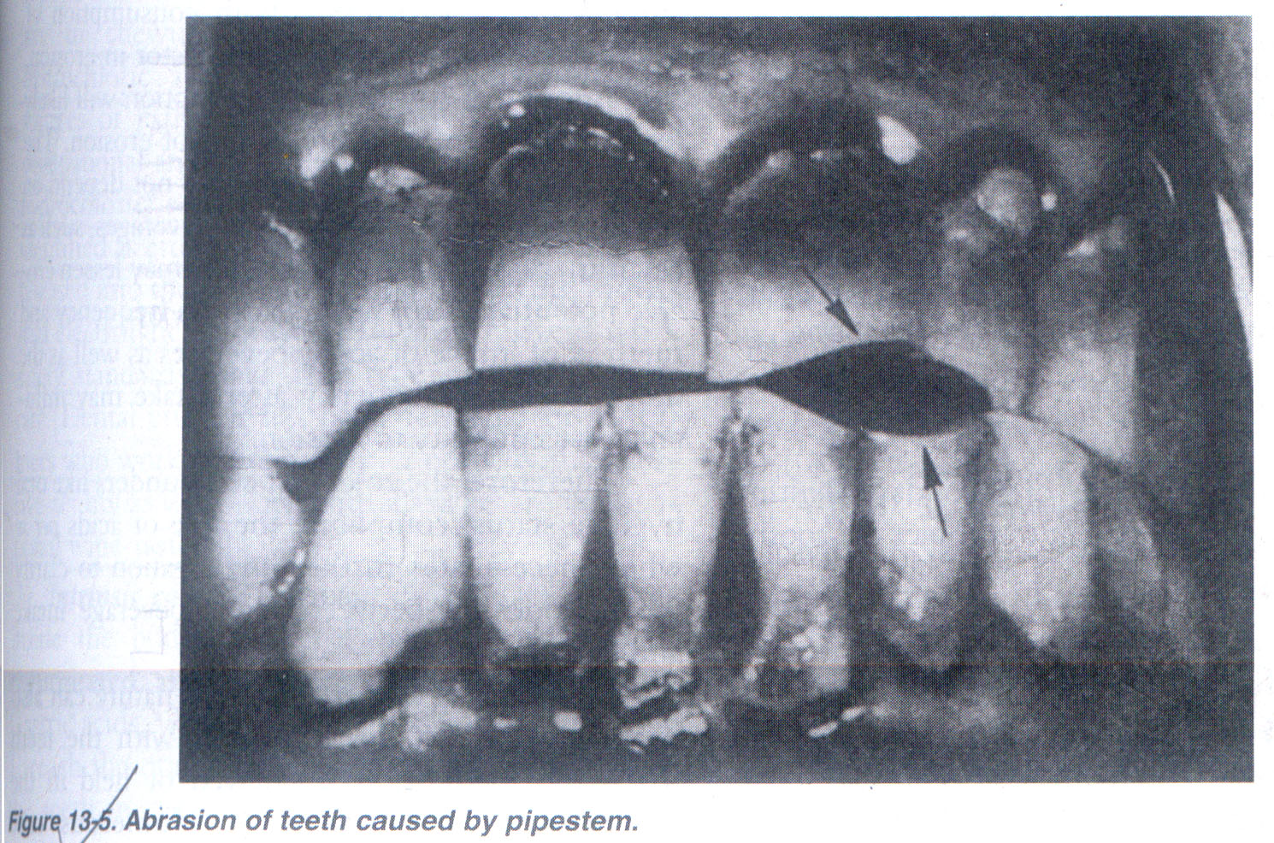

Slide 21
ABRASION
HISTOPATHOLOGY
  The exposure of dentinal tubules and the consequent irritation of the odontoblastic processes stimulate the formation of secondary dentin similar to that seen in cases of attrition. Unless the form of abrasion is an extremely severe and rapidly progressive one, the rate of secondary dentin formation is usually sufficient to protect the tooth against pulp exposure.

Slide 22
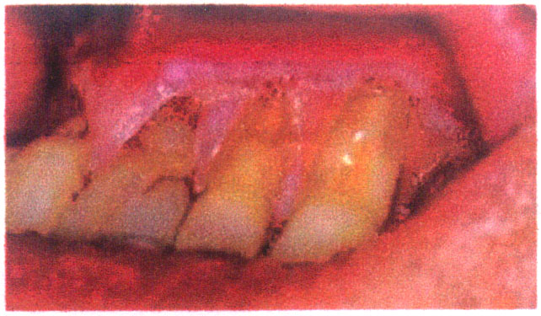
Severe dental abrasion and gingival recession due to long-term traumatic toothbrushing habit.

Slide 23
HOW IS ABRASION REPAIRED ?
TREATMENT
Toothbrush abrasion can be repaired by bonding a tooth coloured restoration over the abraded area of the tooth.
e.g GLASS IONOMER CEMENT, COMPOSITE RESINS
For extensive abrasion, crown therapy can be instituted.

Slide 24
EROSION
Dental erosion is defined as irreversible loss of dental hard tissue by a chemical process that does not involve bacteria.
CAUSES
EXTRINSIC CAUSES
  Erosion of tooth substance is mainly due to contact with acidic media either by way of food stuff or by iatrogenic exposure.
  Examples of extrinsic acids (source outside the body) are acidic beverages, foods, medications or environmental acids. The most common of these are dietary acids. It can be seen that citrus fruits and fruit juices have a very low pH (high acidity). Carbonated drinks and sports drinks are also very acidic.
  The erosive potential of beverages does not depend on pH alone.
  Factors such as frequency and method of intake of acidic beverages as well as the tooth brushing frequency after intake may influence susceptibility to erosion.
  Erosion secondary to chewing vitamin C preparations or hydrochloric acid supplements.

Slide 25
EROSION
  Less common sources of extrinsic erosive acids are related to occupational and recreational exposure. Chromic, hydrochloric, sulfuric and nitric acids have been identified as erosion-causing acid vapors. They are released into the work environment during industrial electrolytic processes.
  Dental erosion has been reported in swimmers who work out regularly in pools with excessive acidity as well as individuals who are occupational wine-tasters.
  INTRINSIC CAUSES:
  Gastric acids regurgitated into the esophagus and mouth.
  Gastric acids, with pH levels that can be less than 1, reach the oral cavity and come in contact with the teeth in conditions such as gastroesophageal reflux and excessive vomiting related to eating disorders like anorexia nervosa or bulimia.
  Erosion caused by vomiting typically affects the palatal surfaces of the maxillary teeth.
  Erosion associated with alcoholism is caused by frequent vomiting. Other causes of vomiting that may cause erosion include gastrointestinal disorders such as peptic ulcers or gastritis, pregnancy, drug side effects, diabetes or nervous system disorders.

Slide 26
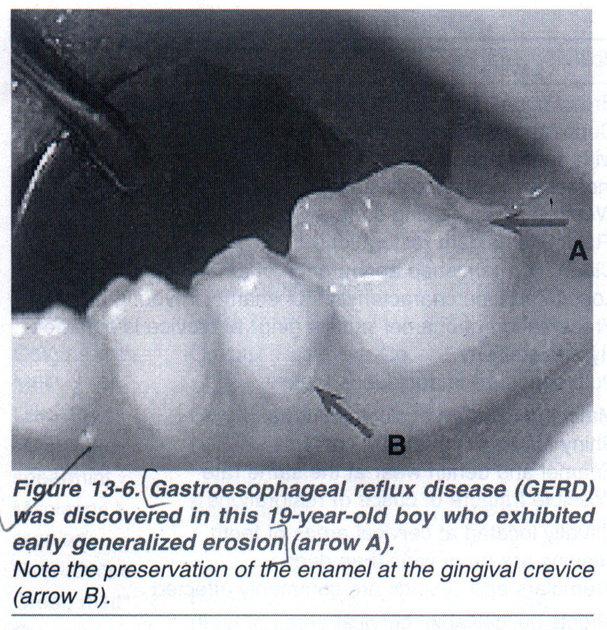

Slide 27
TAKE HOME MESSAGE
Wear is a natural process that occurs whenever two or more surfaces
move in contact with one another.
In the complex environment of the oral cavity where the teeth with any
restorations move in contact with one another, wear is inevitable.
As patients are now retaining their natural dentition for many more
years the clinical problems associated with advanced wear is also
increasing.
The management of wear involves the replacement of missing tooth
tissue with dental materials together with an attempt to minimise the
causative factors.
Therefore it is vital that we should have good knowledge of the etiology
and contributory factors of the different forms of wear seen in the tooth
tissues and their management.

Slide 28
QUESTIONS
Define ATTRITION, ABRASION and EROSION
BRUXISM and its management
Classify Non-carious tooth lesions
Discuss various CAUSES of non-carious tooth lesions

Slide 29
REFERENCES
Science Of Dental Materials -----By ANUSAVICE, Skinners.
Restorative Dentals Materials 11th Edition By Craig.
Operative Dentistry 2nd Edition By Summit, Robbins, Schwarts

Slide 30
SUGGESTED READING
Science Of Dental Materials -----By ANUSAVICE, Skinners.
Restorative Dentals Materials 11th Edition By Craig.

